Slide 1
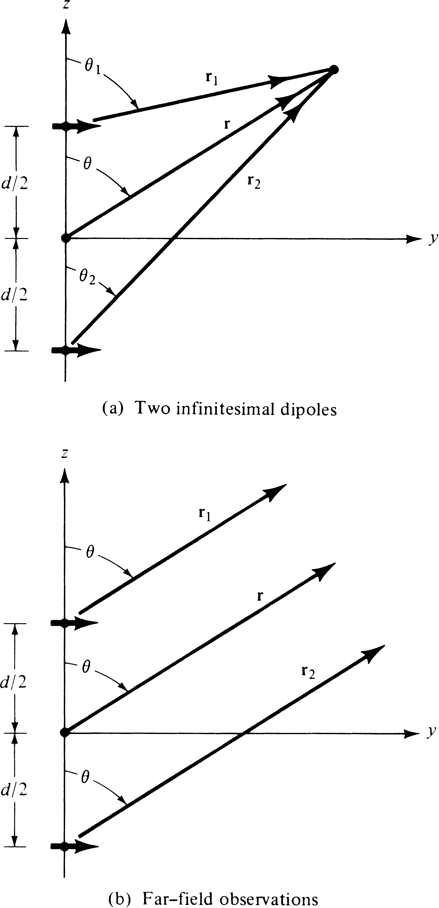
Butler Matrix
Antenna Array

Slide 2
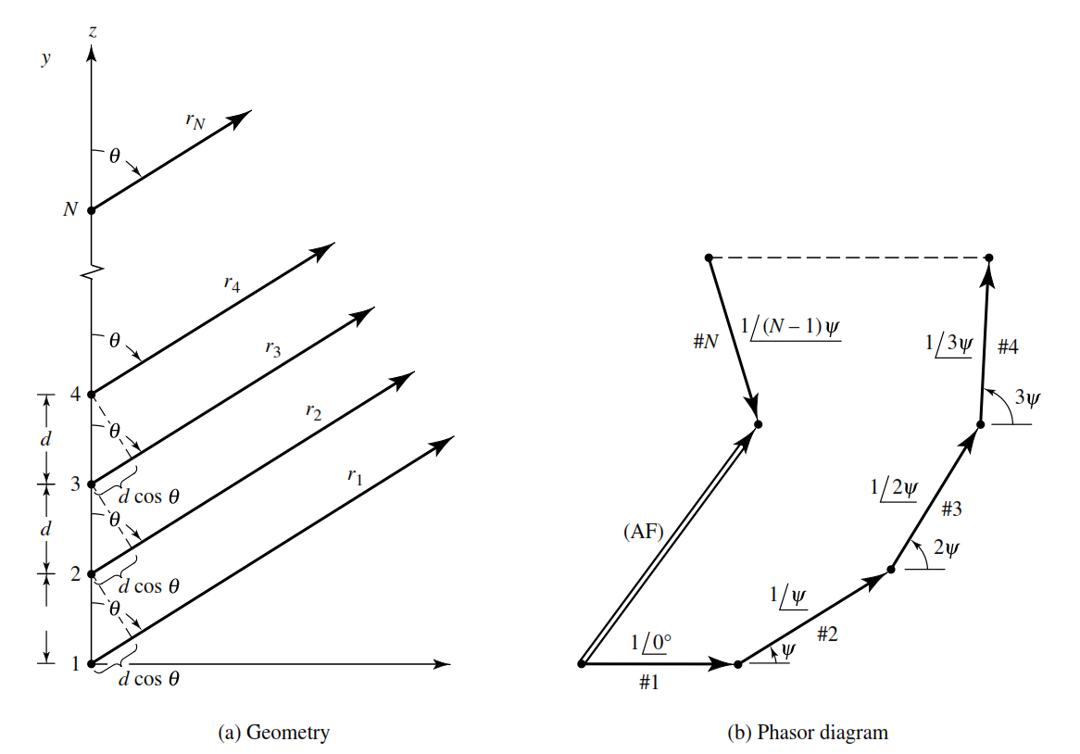
Butler Matrix

Slide 3
Butler Matrix
`
Where Ψ = kd cosθ + β

Slide 4
Butler Matrix
Phased Array :
Maximum of the Array factor (Field) occurs at
Ψ = kd cosθ + β =0
β = - kd cosθ
controlling the progressive phase difference between the elements, the maximum radiation can be squinted in any desired direction to form a scanning array

Slide 5
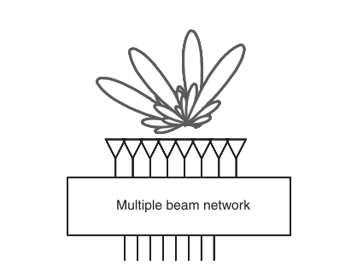
Butler Matrix
Multi Beam Array Feed :

Slide 6
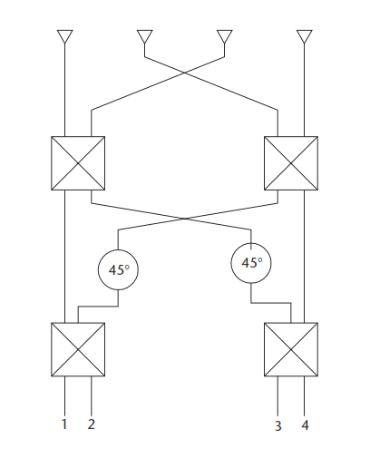
Butler Matrix
4x4 Butler Matrix Beamformer :
Hybrid coupler
Cross coupler
45º phase shifter

Slide 7
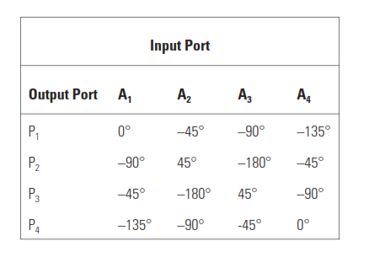
Butler Matrix
4x4 Butler Matrix Beamformer :
Phases at Array Elements in a 4x4 Butler matrix

